Slide 1
Café Great
MRA Assignment

Slide 2
Café Great
Background
The data set provided constitutes the data of a Café Chain for one of its restaurants. Analyze the dataset with the POS information and come up with the following analysis:
• Exploratory Analysis
• Menu Analysis
Dataset : Café Great Transaction Data set.xlsb
Exploratory Analysis
Exploratory Analysis of data & an executive summary of your top findings, supported by graphs.
What kind of trends do you notice in terms of consumer behavior over different times of the day and different days of the week? Can you give concrete recommendations based on the same?
Are there certain menu items that can be taken off the menu?
Are there trends across months that you are able to notice?
Menu Analysis
Identify the most popular combos that can be suggested to the restaurant chain after a thorough analysis of the most commonly occurring sets of menu items in the customer orders. The restaurant doesn’t have any combo meals. Can you suggest the best combo meals?

Slide 3

Café Great
Exploratory Analysis

Slide 4
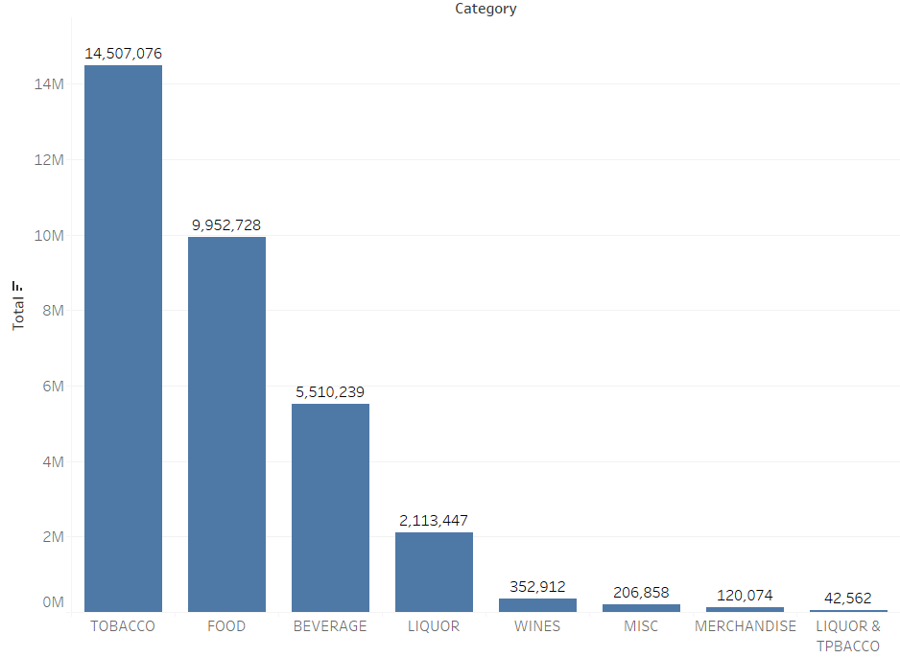
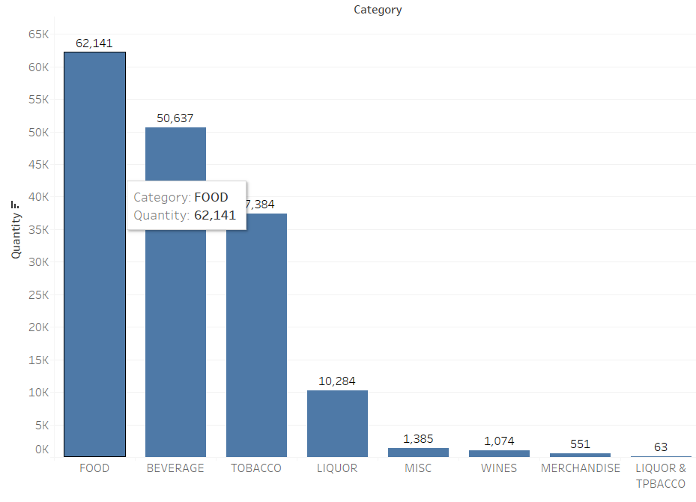
Café Great
Revenue and Quantity Contribution to each Category
Share of Revenue Share of Quantity
Food and Beverages Item sells more but Tobacco contributes highest to the Sales generating more Revenue

Slide 5
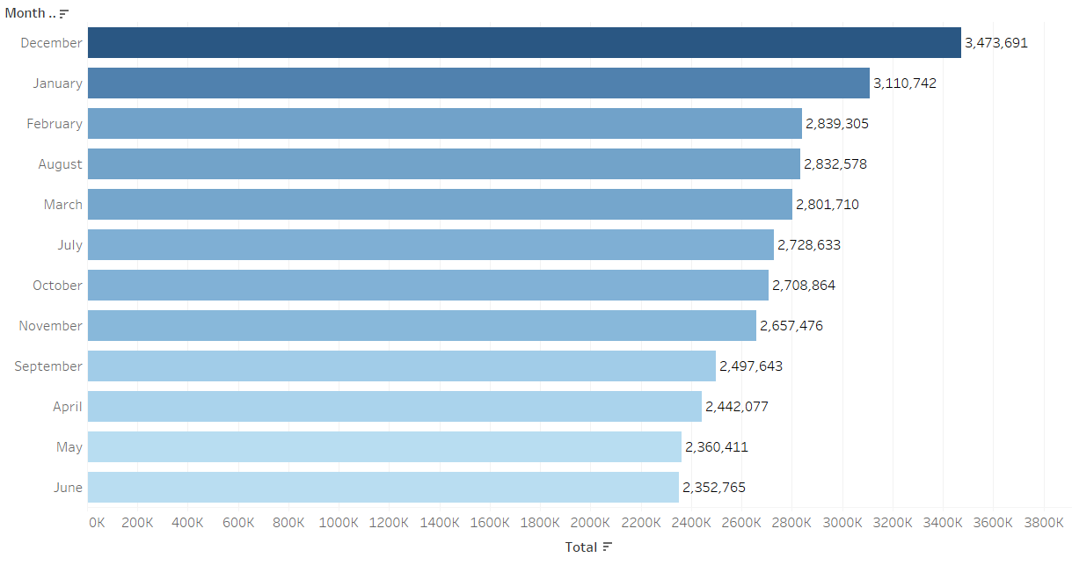
Café Great
Total Sales by Month
December month has generated the highest revenue followed by January
June month has generated the lowest revenue

Slide 6
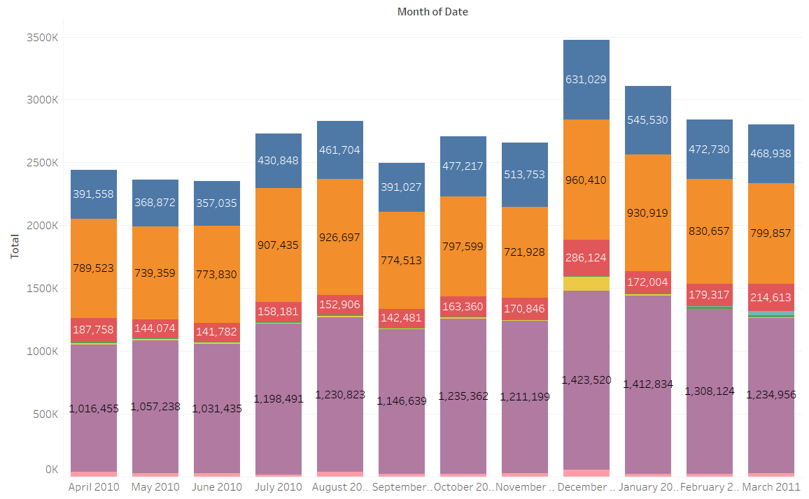
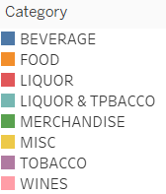
Café Great
Sales contribution Category wise by Month
Tobacco, Food and Beverages are the top contributors to Revenue every Month

Slide 7
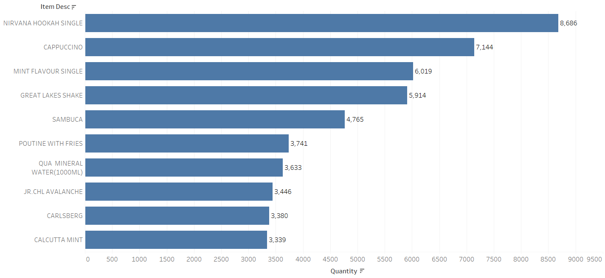
Café Great
Top 10 Items preferred by the Customers
Nirvana Hookah Single is the most preferred item by the Customers followed by Cappuccino

Slide 8
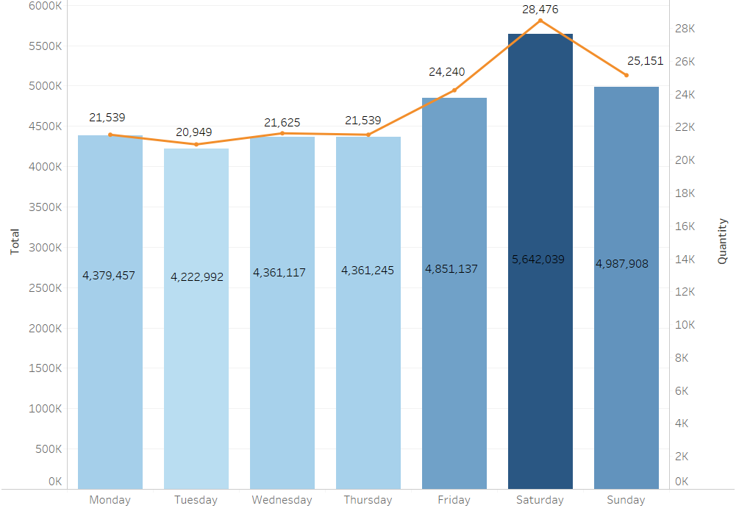
Café Great
Day of the Week Sales Trend
Sales have an upward trend from Friday, with Saturday being the highest.
Weekdays are less busy

Slide 9
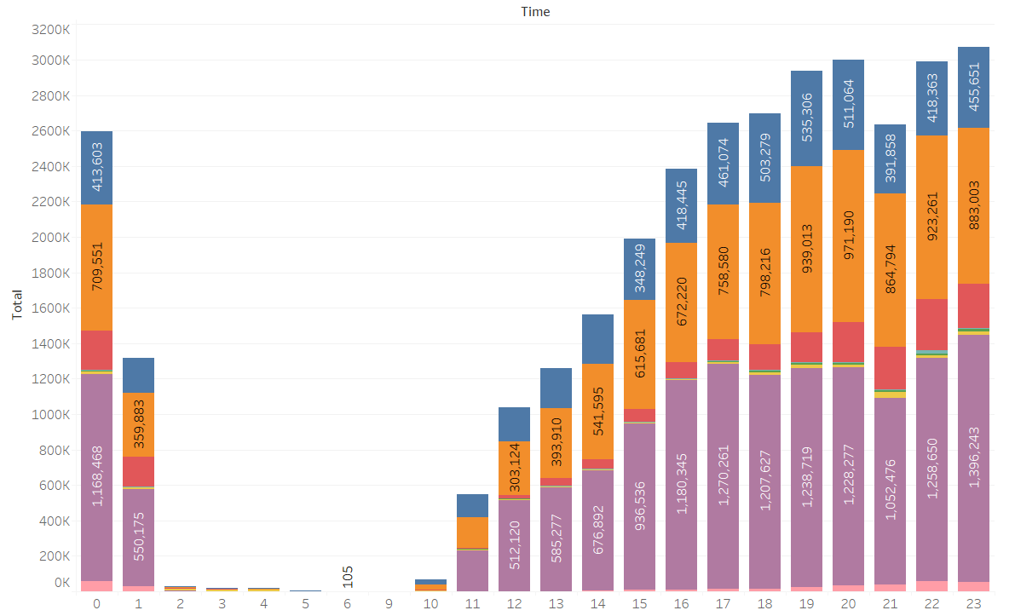
Café Great
Hour of the Day Sales Trend
Sales shows a steady progress from 11am onwards
Café makes maximum sales between 4pm – 12am
Sales are at the minimum between 2am – 10am

Slide 10
Café Great
Top Selling Items at different times of the day
2am to 10:59am
Cappuccino
Great Lakes Shake
Red Bull Energy Drink
Red Bull sheesha
Caffe Latte
Masala Chai cutting
11am to 3:59pm
Nirvana Hookah Single
Cappuccino
Mint Flavor Single
Great Lakes Shake
Qua Mineral Water (1000ML)
Sambuca
Calcutta Mint
Poutine with Fries
Caffe Latte
BMT Panini
Lemon Iced tea
Masala chai cutting
Phillycream cheese & chilly pan
Jr CHL Avalanche

Slide 11
Café Great
Top Selling Items at different times of the day
4pm to 7:59pm
8pm to 10:59pm
Nirvana Hookah Single
Cappuccino
Great Lakes Shake
Mint Flavor Single
Sambuca
Poutine with Fries
Calcutta Mint
Masala chai cutting
Jr CHL Avalanche
Qua Mineral Water (1000ML)
BMT Panini
Lemon Iced tea
Caffe Latte
Nirvana Hookah Single
Cappuccino
Mint Flavor Single
Great Lakes Shake
Carlsberg
Sambuca
Poutine with Fries
Tuborg
Jr CHL Avalanche
BMT Panini
Moroccan Mint Tea
11pm to 1:59am
Nirvana Hookah Single
Mint Flavor Single
Sambuca
Cappuccino
Great Lakes Shake
Qua Mineral Water (1000ML)
Carlsberg

Slide 12
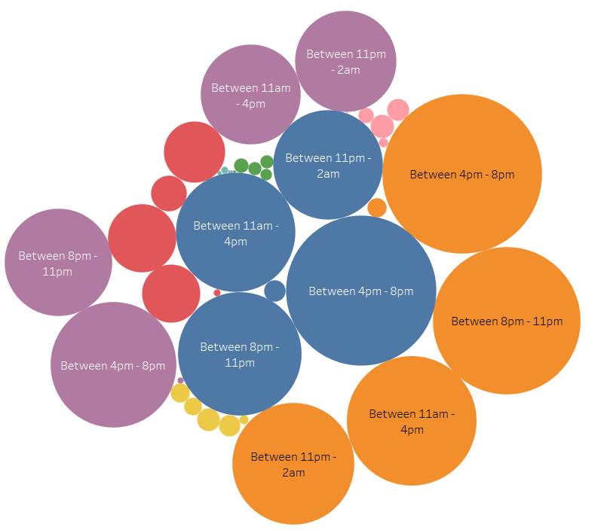
Café Great
Customer preferences based on time of the day
Peak time for selling Food is between 4pm – 8pm followed by 8pm-11pm
Peak time of consumption of Beverages is also between 4pm – 8pm
Peak time for selling Tobacco products are also between 4pm – 8pm
Peak time for selling Liquor and Wines are between 8pm – 11pm

Slide 13
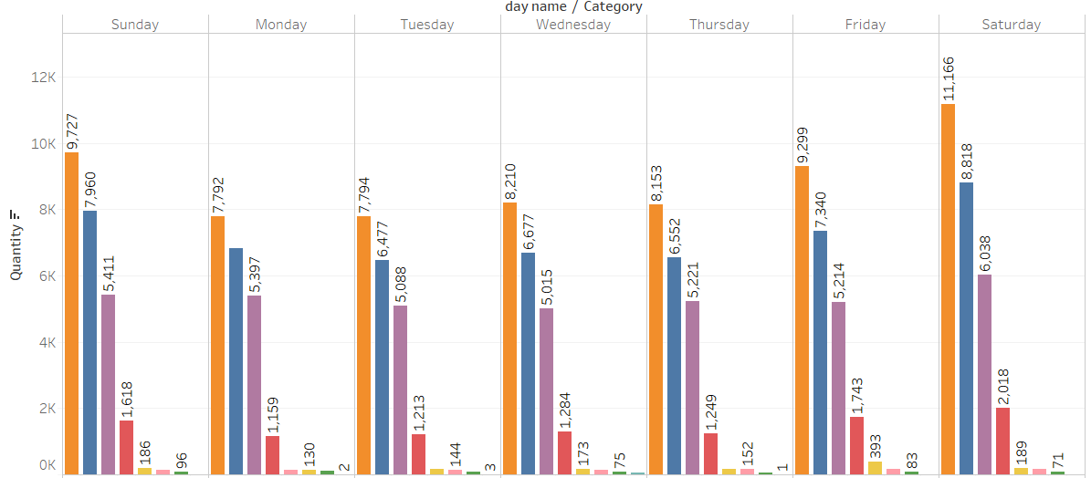
Café Great
Customer preferences based on Day of the week
Customers preferences of the Category is pretty much constant for every day of the week with Food being sold the highest followed by Beverage and Tobacco

Slide 14
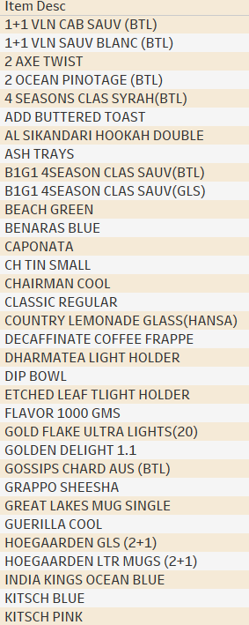
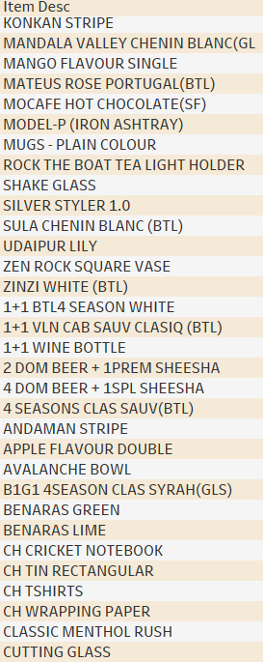
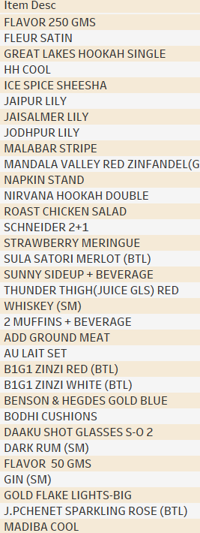
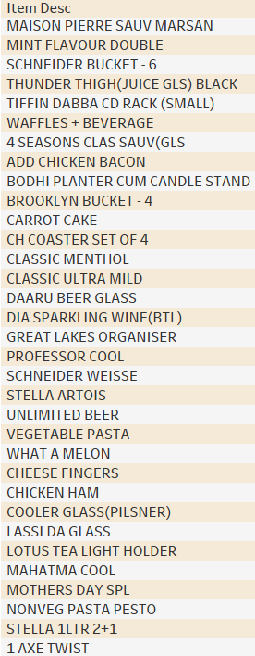
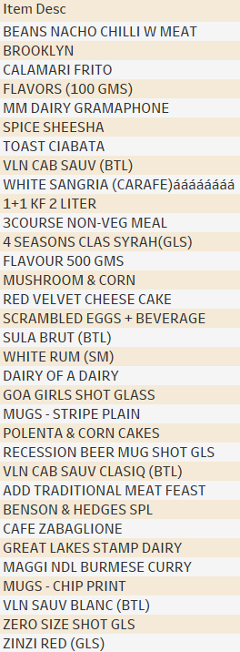
Café Great
Items that can be taken off the Menu
There are about 316 Items that were ordered less than 50 times in an entire year. These items can be taken off the Menu after discussion

Slide 15
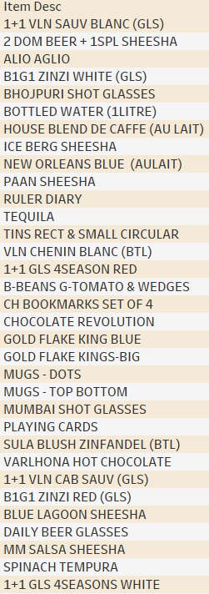
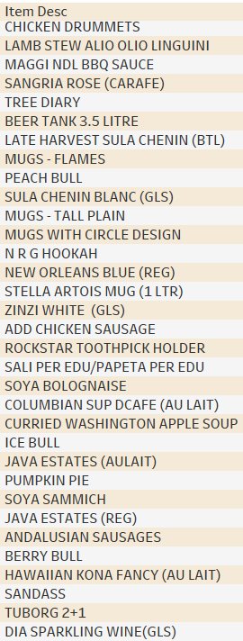
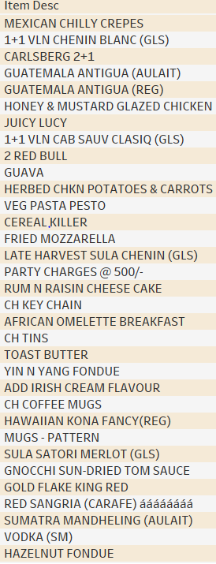
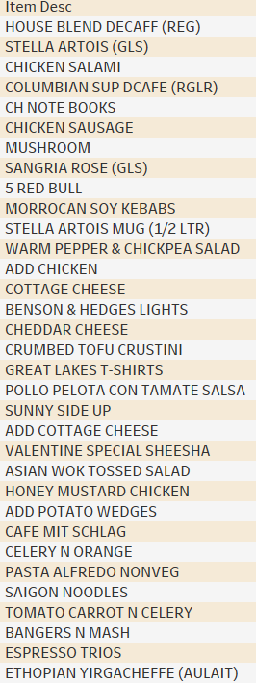
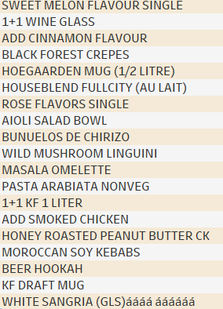
Café Great
Items that can be taken off the Menu

Slide 16
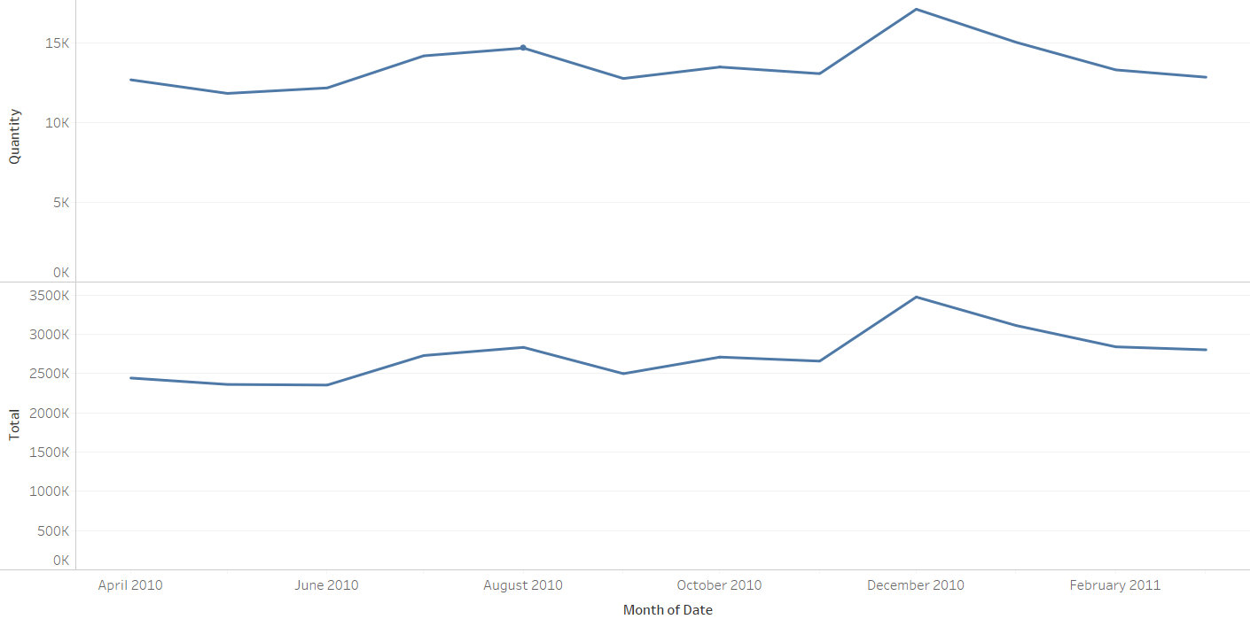
Café Great
Trends across the Month
The month of December has the highest sales
After a drop in sales in June, there is a gradual increase in sales in the month of July and August

Slide 17
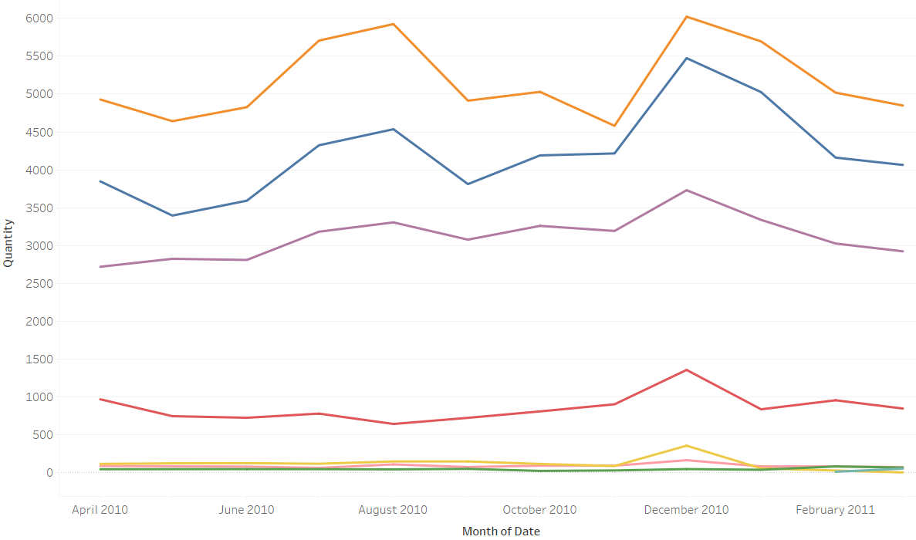
Café Great
Trends across the Month – Category wise
The months of July, August and December notice sharp increase in sales for Food and Beverages
From April to June the sales is usually low for all the products

Slide 18
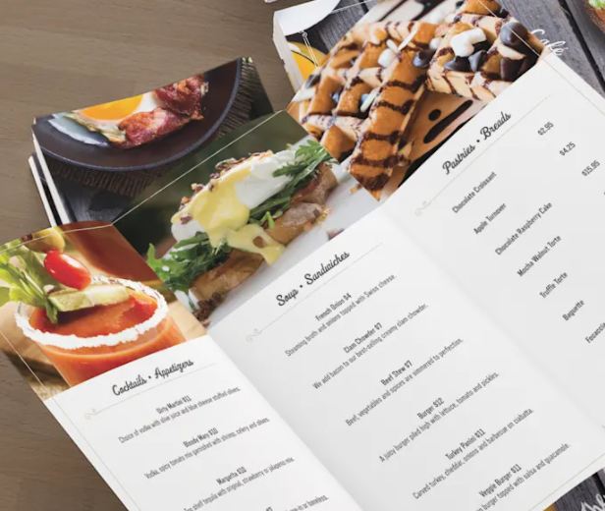
Café Great
Menu Analysis

Slide 19
Café Great
Suggestions For Best Combo Meals
On performing a Market Basket Analysis of the Menu items based on the purchasing pattern of the customers, below is the list of Most preferred combos
Item -Consequent | Item - Antecedent | Confidence | Lift
Caffe latte | ADD VANILLA FLAVOUR | 80% | 26.7
 | ADD CARAMEL FLAVOUR | 64% | 21.3
 | ADD HAZELNUT FLAVOUR | 55% | 18.2
 | ADD IRISH CREAM FLAVOUR} | 64% | 21.4
 | ADD CINNAMON FLAVOUR | 62% | 20.9
Sambuca | GREAT LAKES SHAKE,QUA MINERAL WATER(1000ML),RED BULL 2+1 | 93% | 14.8
 | B.M.T. PANINI,MAGGI NDL ARRABIATA,QUA MINERAL WATER(1000ML) | 80% | 12.7
 | GREAT LAKES SHAKE,QUA MINERAL WATER(1000ML),RED BULL ENERGY DRINK | 70% | 11.1
 | MAGGI NDL ARRABIATA,RED BULL 2+1} | 54% | 8.6
 | QUA MINERAL WATER(1000ML),RED BULL 2+1 | 53% | 8.5
 | GREAT LAKES SHAKE,RED BULL 2+1 | 51% | 8
 | B.M.T. PANINI,GREAT LAKES SHAKE,QUA MINERAL WATER(1000ML) | 47% | 7.5
 | B.M.T. PANINI,MAGGI NDL ARRABIATA | 47% | 7.4
 | B.M.T. PANINI,RED BULL 2+1 | 41% | 6.6
 | MAGGI NDL ARRABIATA,QUA MINERAL WATER(1000ML) | 40% | 6.3
 | MAGGI NDLCREAM/ CHEE/GARLIC,RED BULL 2+1 | 41% | 6.4
 | PHILLYCREAM CHEESE &CHILLY PAN,RED BULL 2+1 | 45% | 7.1
N R G HOOKAH | 2 RED BULL | 100% | 3332.5
NIRVANA HOOKAH SINGLE | MOROCCAN MINT TEA,QUA MINERAL WATER(500ML) | 56% | 4.7
 | QUA MINERAL WATER(500ML),RED BULL ENERGY DRINK | 48% | 4
B.M.T. PANINI | MAGGI NDL ARRABIATA,QUA MINERAL WATER(1000ML),SAMBUCA | 62% | 16.8
 | ADD FRIES,MASALA CHAI CUTTING | 37% | 9.8
 | MAGGI NDL ARRABIATA,SAMBUCA} | 36% | 9.7
 | ADD FRIES,NIRVANA HOOKAH SINGLE | 36% | 9.6
 | CALCUTTA MINT,MAGGI NDL ARRABIATA | 35% | 9.3
SAIGON NOODLES | ADD CHICKEN | 55% | 959.4
KHEEMA GHOTALA | BUTTERED TOASTS | 46% | 101.9
GREAT LAKES SHAKE | VANILLA ICECREAM | 41% | 5.9
 | ADD WHIPPED CREAM | 39% | 5.6
LEMON INFUSED CHAR GRILLED VEG | ADD HERB ROAST CHICKEN | 46% | 79.4

Slide 20
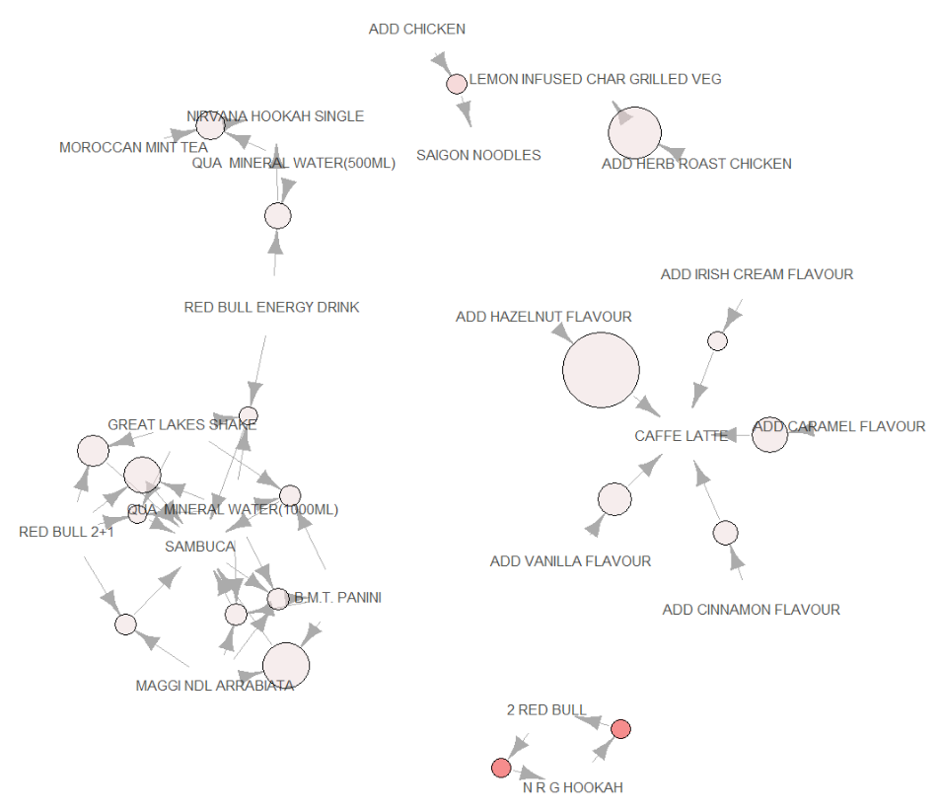

Café Great
Suggestions For Best Combo Meals
Graph of Association for Top 20 rules
Support: It tells us about the combination of items bought together frequently. It gives the part of transactions that contain both Antecedents and Consequents.
Confidence: It indicates how frequently the items Antecedents and Consequents are bought together, for the no. of times Antecedent is bought.
Lift: It indicates the strength of a rule over the randomness of Antecedents and Consequents being bought together. More the lift more is the strength of the rule.

Slide 21
Café Great
Suggestions For Best Combo Meals
N R G Hookah with 2 Red Bull is the most preferred combo by the customers with 100% confidence and a lift of 3332.5
Great Lakes Shake, QUA Mineral water (1000ML), Red Bull 2+1 with Sambuca is also a very popular Combo among the customers with 93% confidence
Saigon Noodles is mostly preferred with Added Chicken which is very clear from a lift of 959.4.
Caffe Latte is mostly preferred with Added Vanilla, Caramel, Irish cream, Cinnamon and Hazelnut Flavors.
Kheema Ghotala is highly preferred with Buttered Toasts which is suggested by a high lift of 101.9

Slide 22
Café Great
Recommendations
Happy Hours offer can be given during afternoon and evening to increase the sales of Liquor
Inclusion of Combo Meals can help in increasing the sales to a very great extent
Discounts and 2+1 offers can be provided during the months of April, May and June to boost the sales during these months
Merchandise products can be combined with other high selling product category and can be provided at a discounted rate to improve the sales
Low selling products as discussed can be removed from the Menu as they don’t constitute much to the revenue.

Slide 23
THANK YOU

